Slide 1
Project Terra
Arbor Animalia

Slide 2
Introduction

Slide 3
Members
Ben Gagliano - Project Manager
Alex Rupp - Developer and Assistant Manager
Chris Dewilde - Developer
Brad Mecurio - Developer

Slide 4
Mission Statement
Our goal is to create an app that allows people to learn and better understand nature.

Slide 5
Project Terra
Use Taxonomy
Nature Education
Mobile access
Easy Use
Create a better resource to Taxonomy

Slide 6
Project Proposal

Slide 7
Client Operations
We are a small operation that is privately funded being the prime candidate to produce the greatest results.

Slide 8
Executive Summary
Initial Consultation - Review systems and practices to formulate a plan
Solution Design - Design a solution for the company that is efficient
Implementation - Begin developing a functional application
Management & Support - Maintaining and Supporting the application

Slide 9
Cost Summary
Phase I - Free
Phase II - $250,000
Phase III - $178,000
Phase IV - $16,000 Monthly

Slide 10
Terms and Conditions
50% up front, 50% upon competition
Business fees due on the first of each month
Addition work charged 75% immediately and 25% on completion
12 month time limit

Slide 11
Statement of Work

Slide 12
Background
Project Terra is a digital collection of life available through a maneuverable representation of a taxonomy tree.

Slide 13
Scope of Work
Assessment
Hardware capability assessment
Code implementation
Data backups
Initial compilation
Debugging
User integration
No outside contracting necessary

Slide 14
Performance
June 16 - August 3 (2022)
Regular meetings are held remotely

Slide 15
Work Requirements
Consistent Communication Online
Code stored and Shared in GitHub Repository
Researching given topics and Communicating said research
Client Program communicates to server to acquire data
Establish authentication service for login and log out
Accurately visualize the the taxonomy tree

Slide 16
SOW Release | June 24, 2022
Period of Performance Begins | June 25, 2022
App Design Review | July 1, 2022
App Implementation Review | July 8, 2022
Implementation Complete | July 22, 2022
Design and Detail Completion | July 29, 2022
Project Completion Review | August 1, 2022
Project Closure/Archives Complete | August 3, 2022
Schedules and Milestone

Slide 17
Acceptance Criteria
Complete a running Program
Client can communicate to server
Establish a login mechanic
Animal names, taxonomy tree, and animal photos viewable by the user

Slide 18
Current Progress

Slide 19
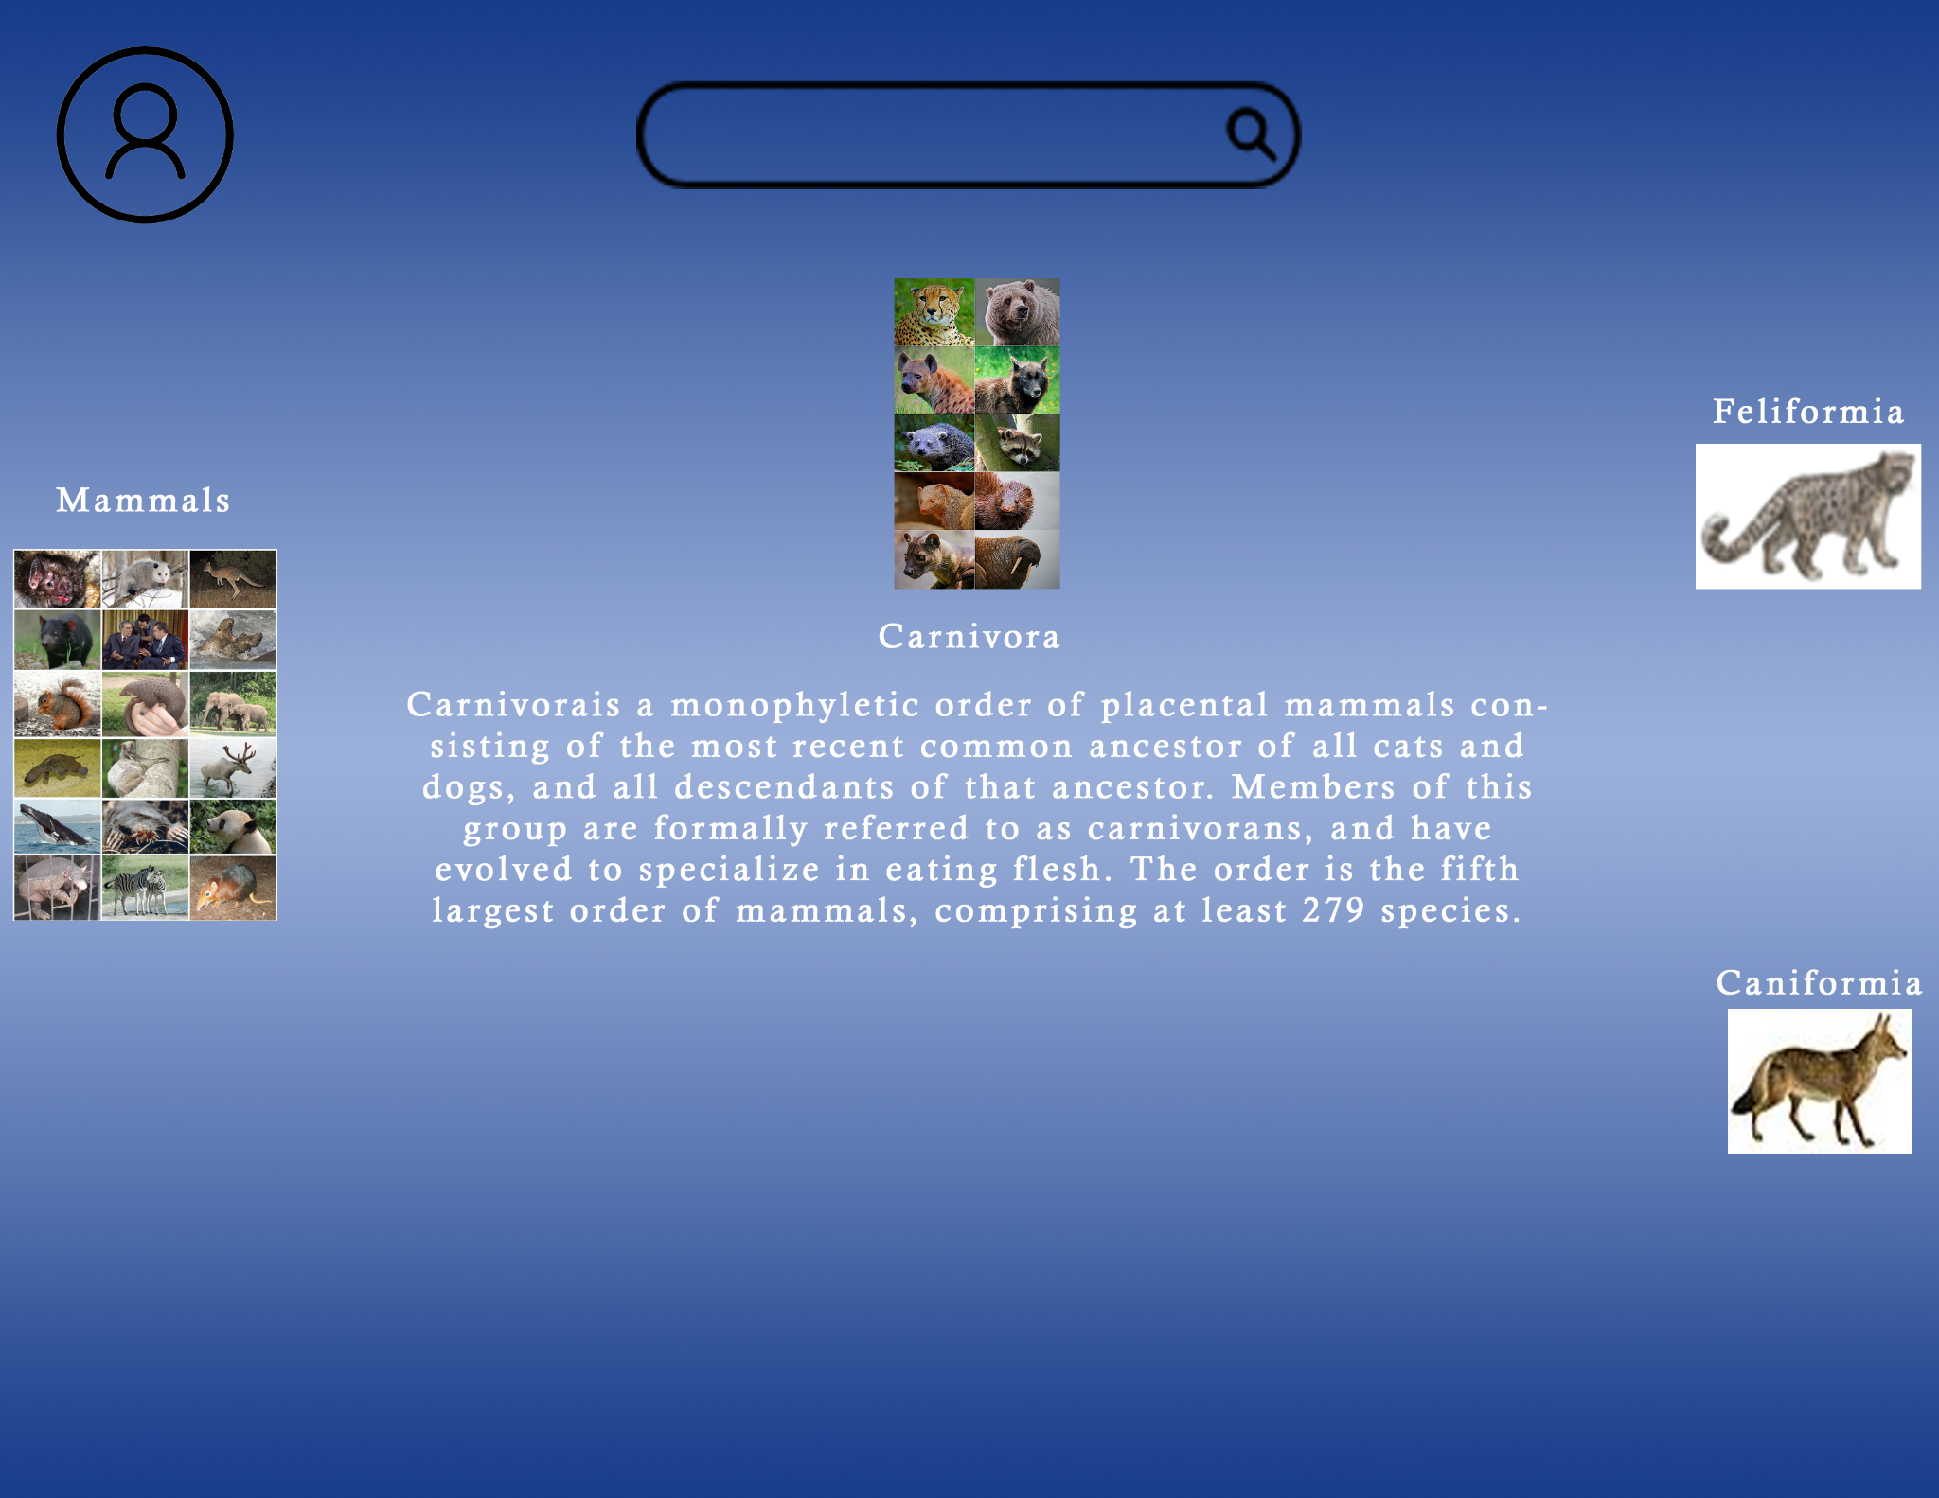
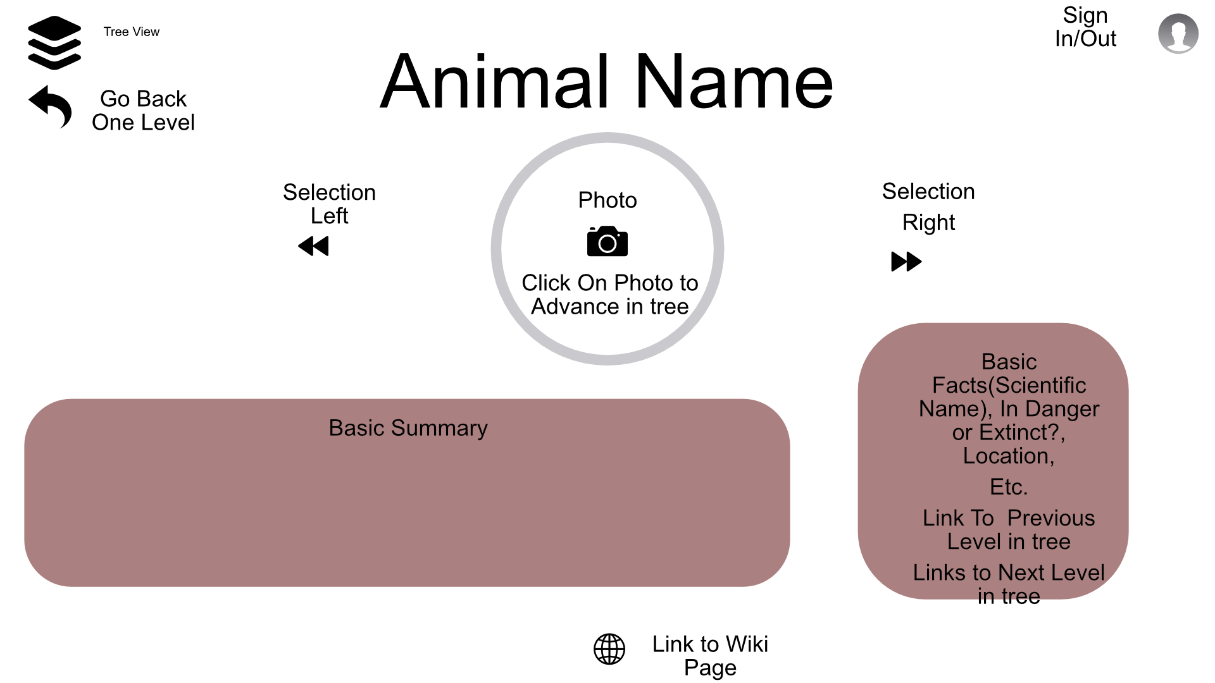
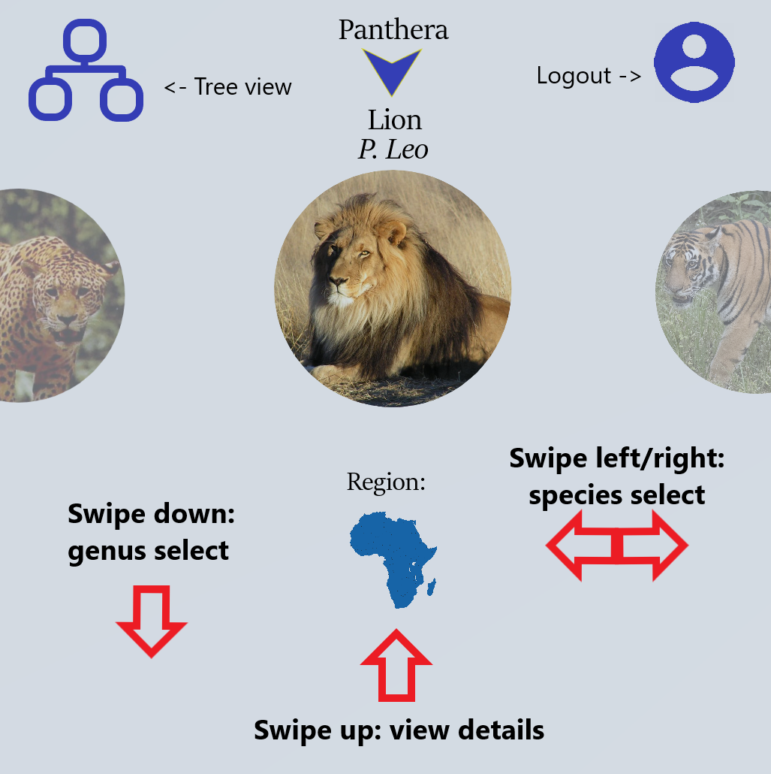
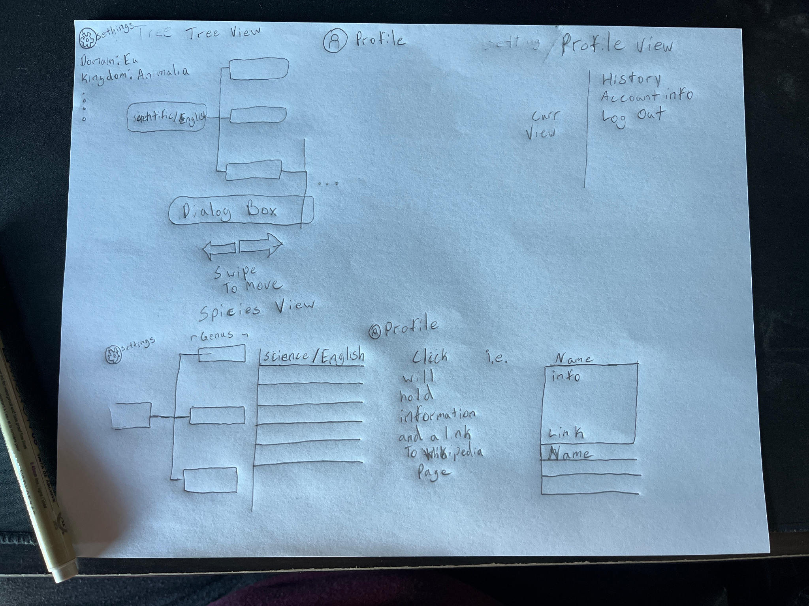
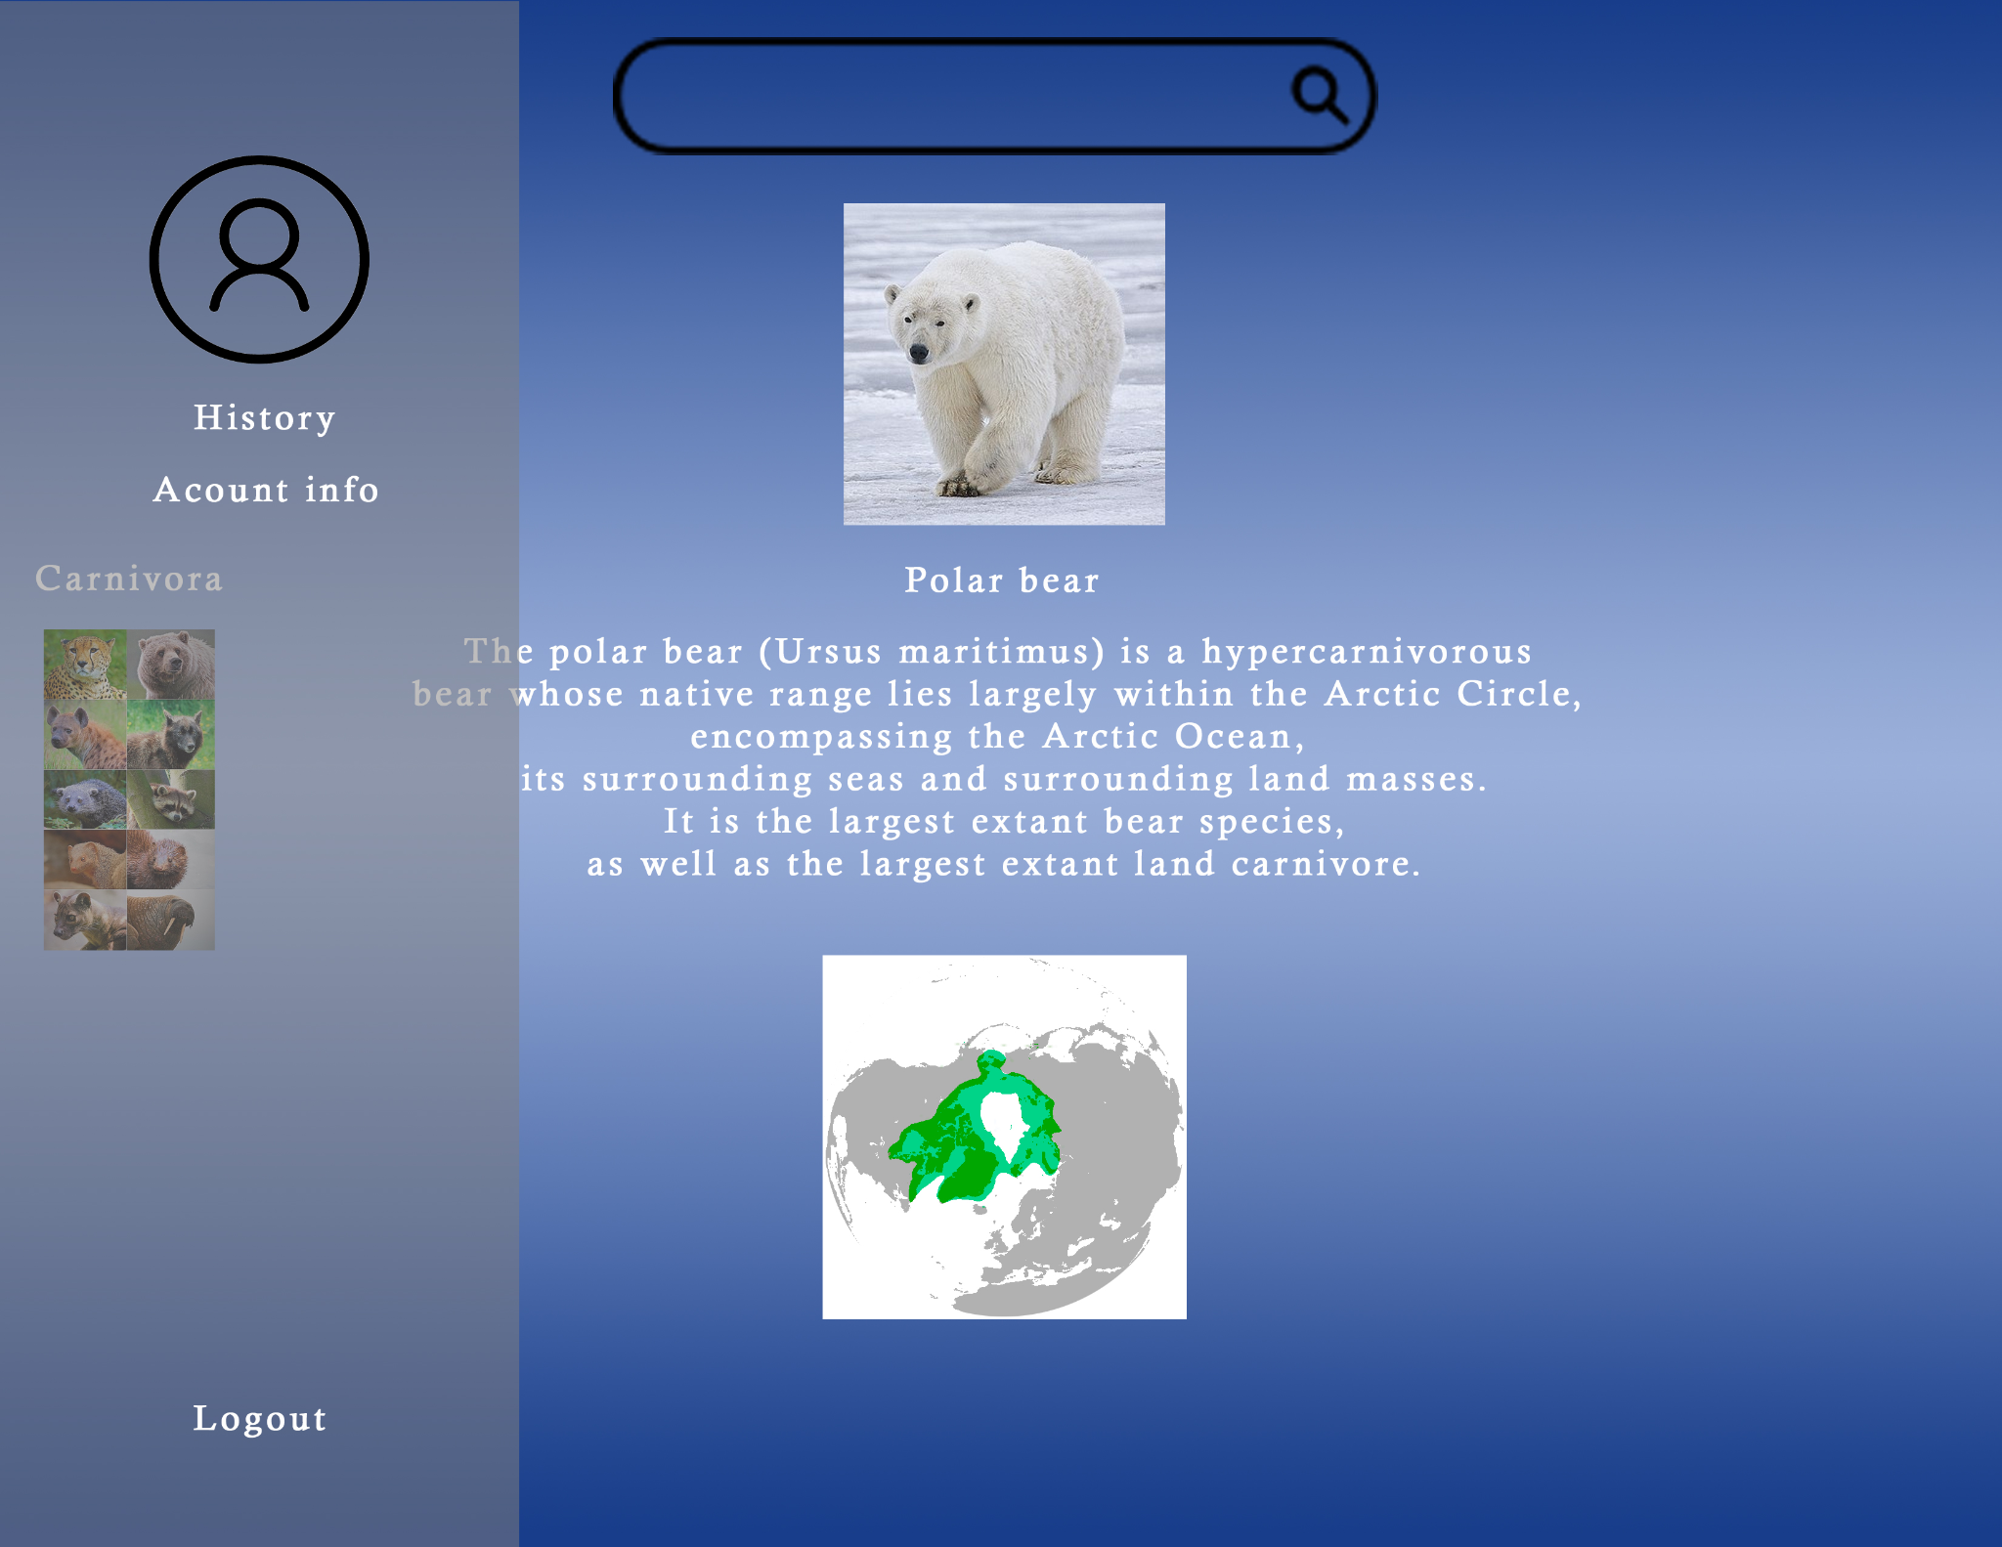
Design

Slide 20
Research Updates
Ben
Alex
Chris
Brad

Slide 21
Future Plans

Slide 22
Plans
The general plan is to have a functional working product that can be slowly updated to completion due to the immense size of taxonomy.
We will initialize implementation of code for the next two weeks and ideally fully design the app within 4 weeks
This will allow 2 weeks od wiggle room.

